Slide 1
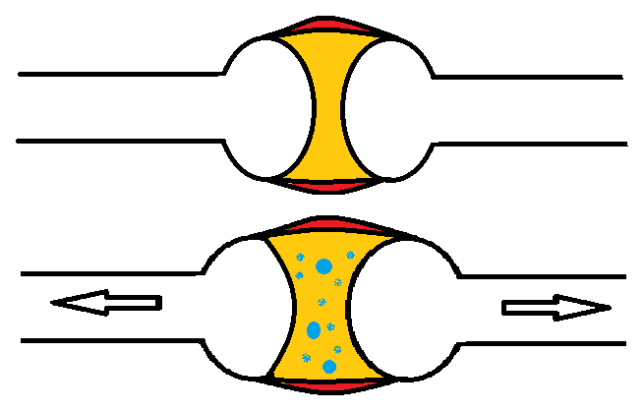
What’s That “Popping” Sound?
Synovial fluid in your joints contains oxygen, nitrogen and carbon dioxide gases. When a joint is adjusted the joint capsule is stretched and the joint volume is increased by as much as 15-20%. This creates a partial vacuum and the gas rapidly releases due to the pressure change. (Similar to Boyle's Law, 1662).
The gas takes about 20 minutes to return to the synovial fluid. There are no studies that suggest “cracking” your knuckles or joints will cause arthritis or harm.
Why Is The 1st Adjustment So Loud?
The joint capsule volume change is typically greatest on the 1st adjustment, as it has never been adjusted and will likely have tighter muscles and more adhesions. The sound on subsequent adjustments SHOULD be less and is a good indicator that the joint is moving more efficiently.

