Slide 1

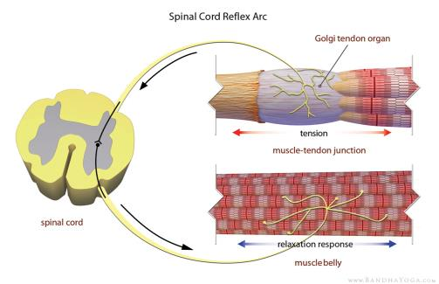
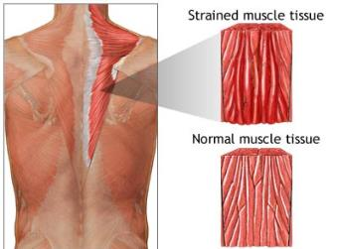
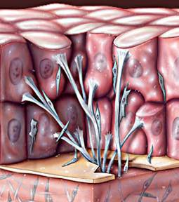
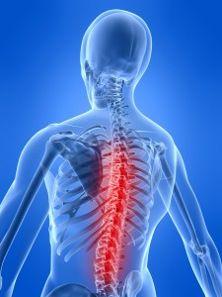
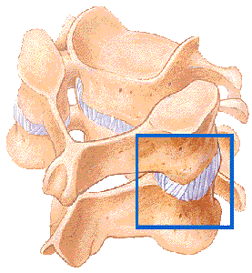
The Chiropractic Adjustment
The speed of the adjustment neurologically relaxes tight muscles
Adjustments stretch and break up soft tissue adhesions
Adjustments allow new chemicals to flow into the cells and acute/chronic inflammatory chemicals to flow out, which helps the healing process
Allows for improved joint motion

