Slide 1
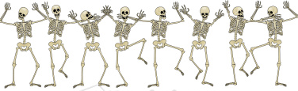
Palmer West
Student Presentation
Presented by
Marcus Strutz, DC

Slide 2
Marcus Strutz, DC
Life Chiropractic College West Graduate
June 1996, Summa Cum Laude
Professor Life Chiropractic College West, 1997-2002
Physiotherapy Rehab (authored course manual)
Physiotherapy Modalities (authored course manual)
X-Ray Physics (authored course manual)
Philosophy I
Philosophy V - Practice Management
Microbiology Lab
Spinal Biomechanics
Systemic Physiology Lab

Slide 3
Private Practice, 2000-present Mendocino/Ft Bragg, CA
CE Seminars, 2002-present:
Technique, Wellness (Pt Ed), Physiotherapy, History Taking & Physical Examination Procedures
Ghost Writer Practice Management, 2007-present
National Board Review Instructor, 1999-2000
Dr. Irene Gold & Dr. John Donofrio
Middle School Teacher Math & Science, 1989-1993
Racquetball Club Pro & Weight Trainer
Walnut Creek, 1982-1987
Father: Amuel Strutz DC Palmer Grad 1961
5

Slide 4



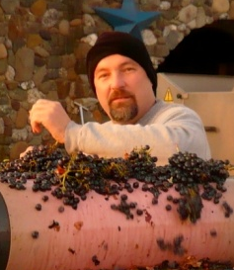

Pacific Star Winery
pacificstarwinery.com

Slide 5

Top 10 Keys To Chiropractic Success
1. Practice Management, Business Skills
2. Extraordinarily Excited To Help People
3. Be Fair To Your Patients
4. Great Bedside Manner
5. Entrepreneurial Spirit
6. No Excuses Attitude
7. Passion For Chiropractic
8. Willingness To Learn/Improve
9. Communication With Patients
10. Be A Great Adjuster

Slide 6

Winners –vs-Losers
Something to think about………

Slide 7
Winners Losers
Makes Commitments
Never Quits
Have the answers
Have dreams
Part of the TEAM
See Possibilities
See Potential
Believe in Win/Win
Makes Promises
Always Quits
Have the excuses
Have schemes
A part from the TEAM
See Problems
See the Past
Believe for them to win somebody has to lose

Slide 8
Winners Losers
“I can do it”
Are the Thermostat
Are part of the Plan
“Let me do it for you”
“It may be difficult but it’s possible”
“Let me see what I can do”
Are the thermometers
Are part of the Problem
“It’s not my JOB”
“It may be possible but it’s too difficult”

Slide 9

Winners Losers
“I was Wrong”
Make it happen
Sees the answer for every problem
“It’s not my fault”
Watch it happen
Sees a problem for every answer

Slide 10

Winners Losers
“Don’t do to others what you would not want them to do to you.”
“Do it to others before they do it to you.”

Slide 11
A Quick Run Down
business startup planning, budgets, financing
have a thorough plan & don’t over or under spend to start
finding a commercial lease, lease types
don’t over or under spend to start, get a contract that makes sense
contracts, negotiations
have solid contracts that are fair to both parties with exit strategies, spend $ on attorneys to get this right
marketing
every way possible
social media for business
every way possible
networking
every way possible, never stop
practice models
visit at least 10 practices not in your area

Slide 12
A Quick Run Down
billing, insurance
figure it out, get it done, don’t let it own you
contact billing companies & other DCs
(an hour in a DCs office could be enough)
EHR
figure it out, get it done, don’t let it own you
HIPAA
figure it out, get it done, don’t let it own you
office procedures, hiring staff
figure it out, get it done, don’t let it own you

Slide 13
Why We Struggle?
AMA bashes us, use of subluxation, false claims “quack”
Too expensive for pain relief vs nothing, pills or alcohol
No marketing, no pharma corporate sponsors?
Results not instantaneous, not symptom based
No money for research
Our associations & colleges disagree
Public scared of audible, think it is bad
We can’t adjust
Can’t fix the problem
Different adjusting styles, approaches & techniques
Explanations, subluxation, alignment, or just can’t explain
Scare tactics for compliance
Different x-ray protocols
Different treatment plans, no standard of care, fail to refer
Idea of maintenance, ongoing care (bait & switch)
Insurance fraud, WC, etc.
If one bad DC, they must all be bad
Lack of professionalism, attire
Spiritual, religious aspect
Spinal screenings

Slide 14
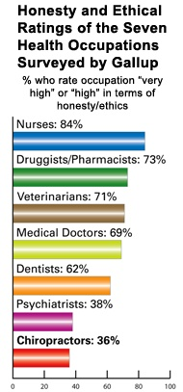
Why Do We Struggle?
college teachers 58%
clergy 58%
policemen 54%
journalists 26%
business executives 18%
lawyers 18%
stockbrokers 17%
senators 15%
insurance salesmen 13%
HMO managers 12%
car salesmen 7%
Gallup poll 1,009 US adults, 2006

Slide 15
What We Do Well!
1. Adjust joints, subluxations
2. Wellness maintenance care ideals
3. Whole body approach
4. Don’t prescribe drugs
5. Prevent surgery
6. Promote self awareness
7. Promote self care
8. Touch patients
9. Allow the body to heal itself
10. Discuss all aspects of health: nutrition, exercise, ergonomics, stretching
11. Excellent bed side manner
12. Provide hope

Slide 16

Interesting Thoughts?
Only 6% of the American population is actively seeking chiropractic care. This leaves an untapped market of 94% of the population.

Slide 17
Are We Making A Mistake?
Humans are motivated by pain. In fact, 80% of all human activity is related to escaping present or future pain. Only 5% of human activity is said to be motivated by pleasure. That is why the constant marketing of wellness care is futile. People do not want to feel good, better or stay healthy. They want the pain to stop. Think about this. People are conditioned not to think about their health in the absence of pain.

Slide 18
Consumers remember firsts, not seconds.
The public associates a business with the one thing that it is best at, not two or more. 84% of chiropractic pts seek care for neck pain, headaches & lower back pain. Only 7% seek care for extremity problems. Other problems have even lower percentages. With this in mind, chiropractic should use neck pain, headaches & lower back pain as the gateways to our recognition in the marketplace. The chiropractic brand then becomes associated with the gateways of neck, headache and lower back pain as Kleenex is associated with tissue. The public simply will not believe that chiropractors can be everything to everybody.

Slide 19
Unfamiliar Terms?
Subluxation, Diversified technique, Innate intelligence, Gonstead technique and Activator technique are terms specific to chiropractic. These terms are known as industrial language. The chiropractic marketplace is typically unfamiliar with these terms. Lack of understanding creates a lack of trust and increases the public’s resistance to buying chiropractic services. Unless your patients have had these terms explained to them, reserve these phrases for intra-professional communications.

Slide 20
What Year Did That Small Business Fail?
Year | % Failed
1 | 25 %
2 | 36 %
3 | 44 %
4 | 50 %
5 | 55 %
6 | 60 %
7 | 63 %
8 | 66 %
9 | 69 %
10 | 71 %

Slide 21
Why Did They Fail?
 | Major Cause | % Failures | Specific Pitfalls
1 | Incompetence | 46 % | Emotional Pricing
 |  |  | Living too high for the business
 |  |  | Nonpayment of taxes
 |  |  | No knowledge of pricing
 |  |  | Lack of planning
 |  |  | No knowledge of financing
 |  |  | No experience in record-keeping
2 | Unbalanced Experience or Lack of Managerial Experience | 30 % | Poor credit granting practices
 |  |  | Expansion too rapid
 |  |  | Inadequate borrowing practices
3 | Lack of Experiences in line of goods or services | 11 % | Carry inadequate inventory
 |  |  | No knowledge of suppliers
 |  |  | Wasted advertising budget
5 | Neglect, fraud, disaster | 1 %

Slide 22
 | Leading Management Mistakes
1 | Going into business for the wrong reasons
2 | Advice from family and friends
3 | Being in the wrong place at the wrong time
4 | Entrepreneur gets worn-out and/or underestimated the time requirements
5 | Family pressure on time and money commitments
6 | Pride
7 | Lack of market awareness
8 | The entrepreneur falls in love with the product/business
9 | Lack of financial responsibility and awareness
10 | Lack of a clear focus
11 | Too much money
12 | Optimistic/Realistic/Pessimistic

Slide 23

Chiropractic Philosophy & Practice Styles
The answer seems obvious: the practice system DOES NOT matter!
What does matter is YOU! If you are 100% all in with a particular practice style then it WILL work. If you are not sure and constantly doubting yourself or the system, then failure is waiting around the corner. Explore all styles and all the angles. Sit down and really think about what makes the most sense to YOU and then do it. The point is, whatever you choose for yourself is fine, just choose what makes sense to you and go all out, 110%!
And as one of my favorite DC’s Scott always says:
“No Excuses!”

Slide 24
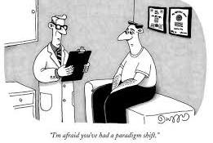
Shift Your Paradigm!
Make a list of 10 things that you know and understand as a chiropractor, that you are pretty sure most of your new patients do not. Here we are attempting to identify the different paradigms between chiropractors and the general population.
Which are the most important for the pt to know?
Now take that list and one-by-one strategize on how to communicate your ideas to the patient.

Slide 25
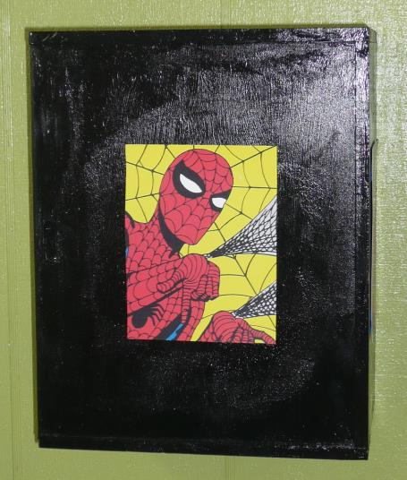
Pricing?

Slide 26
US Income
Income | AGI
Top 1% | Over $369,691
Top 5% | Over $161,579
Top 10% | Over $116,623
Top 25% | Over $69,126
Top 50% | Over $34,338
Bottom 50% | Under $34,338
Santa Clara County has the highest median household income in the nation, at $93,500

Slide 27
How Many Patients Do I Need?
Pts/day | Fee | $/day | $/month | $/yr |  | Pts/day | Fee | $/day | $/month | $/yr
10 | $20 | $200 | $4,000 | $48,000 |  | 10 | $35 | $350 | $7,000 | $84,000
15 | $20 | $300 | $6,000 | $72,000 |  | 15 | $35 | $525 | $10,500 | $126,000
20 | $20 | $400 | $8,000 | $96,000 |  | 20 | $35 | $700 | $14,000 | $168,000
25 | $20 | $500 | $10,000 | $120,000 |  | 25 | $35 | $875 | $17,500 | $210,000
30 | $20 | $600 | $12,000 | $144,000 |  | 30 | $35 | $1,050 | $21,000 | $252,000
10 | $25 | $250 | $5,000 | $60,000 |  | 10 | $40 | $400 | $8,000 | $96,000
15 | $25 | $375 | $7,500 | $90,000 |  | 15 | $40 | $600 | $12,000 | $144,000
20 | $25 | $500 | $10,000 | $120,000 |  | 20 | $40 | $800 | $16,000 | $192,000
25 | $25 | $625 | $12,500 | $150,000 |  | 25 | $40 | $1,000 | $20,000 | $240,000
30 | $25 | $750 | $15,000 | $180,000 |  | 30 | $40 | $1,200 | $24,000 | $288,000
10 | $30 | $300 | $6,000 | $72,000 |  | 10 | $45 | $450 | $9,000 | $108,000
15 | $30 | $450 | $9,000 | $108,000 |  | 15 | $45 | $675 | $13,500 | $162,000
20 | $30 | $600 | $12,000 | $144,000 |  | 20 | $45 | $900 | $18,000 | $216,000
25 | $30 | $750 | $15,000 | $180,000 |  | 25 | $45 | $1,125 | $22,500 | $270,000
30 | $30 | $900 | $18,000 | $216,000 |  | 30 | $45 | $1,350 | $27,000 | $324,000

Slide 28
Today’s Goals:
Create materials effective in educating your patients
Initial intake form changes:
things patients need to know before starting care
frequently asked questions
common misconceptions
Self-evaluation initial questionnaire & re-eval form
Demonstration tables, posters, white board & quizzes
Take home info packet (call the new patient)
Free Materials on our website under Helping Hands
(Post on office walls, website & in take home info packet)

Slide 29

Lets start of with an attitude adjustment!
“Despite everything,
life is good!”
Anne Frank
1929-1945
She was so right, no matter what happens
we need to enjoy life & seek the positive!
Please Find 520 Fun Facts & Quotes
backtochiropractic.net
Free Materials

Slide 30
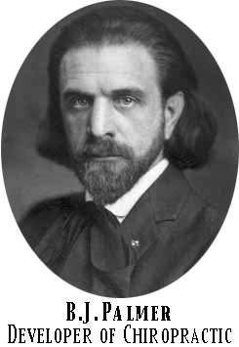
"The preservation of health is easier than the cure for disease."
-BJ Palmer

Slide 31
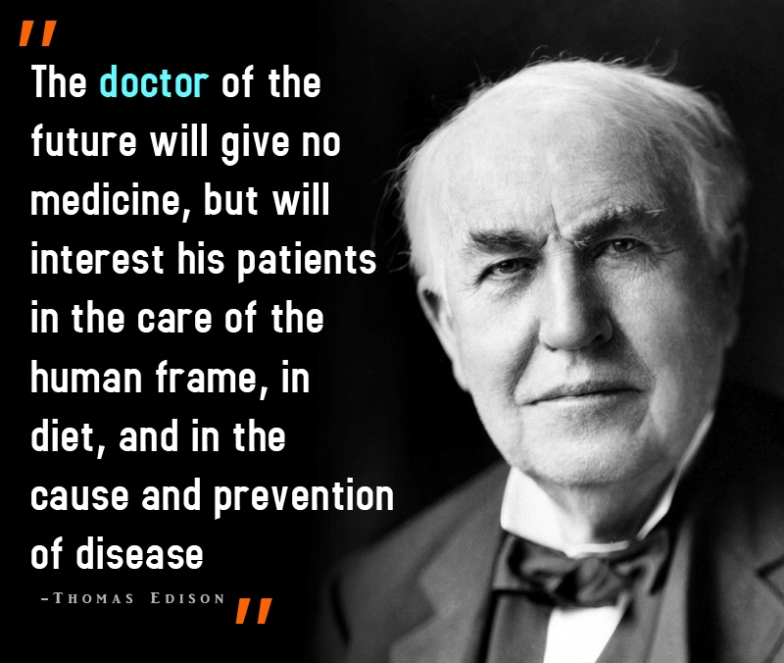

Slide 32


“People increasingly see conventional medicine not as health care but as disease care.
People want more than that.
It’s irrational to always wait until one develops a problem to pay attention to one’s health.”
Larry Dossey, MD

Slide 33
The Alternative!
Don’t wait until you are sick,
maintain your health!
The goal is to live long & be healthy, achieving a more effective life, maintaining full function & well-being. The goal of chiropractic care is correction of dysfunction with pain relief, restored function & enhancement of well-being. DC’s make patients aware of their role & responsibility in maintaining their health.
backtochiropractic.net
Free Materials

Slide 34
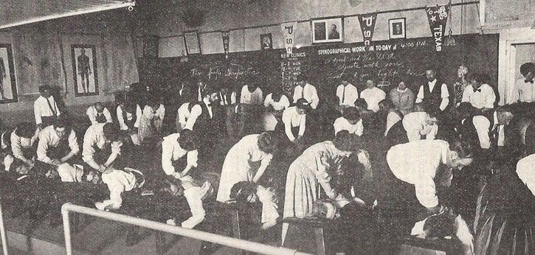
“If the public knew what we know, we’d need a lot more chiropractors.”
~ Marcus Strutz DC

Slide 35

Some Key Ideas for Successful Communication

Slide 36

What Pts Think!
Your Perception Is Your Reality!
“Truth will always be truth, regardless of lack of understanding, disbelief or ignorance.”
~ William Clement Stone
Always remember that pts may
interpret things you say differently then you intended.

Slide 37
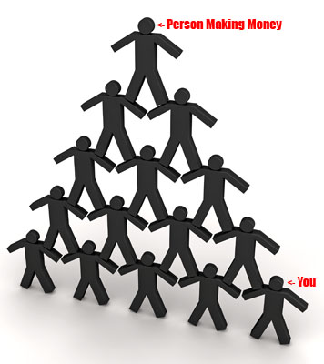
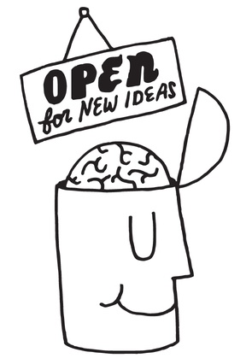

How do you respond to a new idea?
Often people are hesitant & apprehensive. Remember chiropractic is a new idea to many people & of course they may have already passed judgement before they see you.

Slide 38

Activity
Can We Change Our Own Behavior?
Only 1% keep their New Year’s Resolution for the year. 93% blow it by Jan 12th!
Try this: List your top 3 personal flaws.
They can be anything, (lose weight, be more tolerant, etc.)
If you can’t think of any perhaps that is one of your flaws.
Also your partner probably already has the list.
Now I bet two things:
1. You have had these flaws for a long time.
2. you’ve tried changing these flaws before & have failed
ME TOO!
Lesson: No matter how smart you are, you still struggle to change your behavior. So remember when you’re coaching patients, be more empathetic, as they may struggle too.

Slide 39


Shifting Paradigms?
Pluto Not A Planet?
Science says NO to Pluto, but for those of us who grew up being taught Pluto was a planet & we’ll likely keep that belief no matter what the scientists say.
Now relate that same principle to your patient’s mindset, they grew up with the medical model and…
Lesson learned! It takes a lot to change someone’s beliefs.

Slide 40
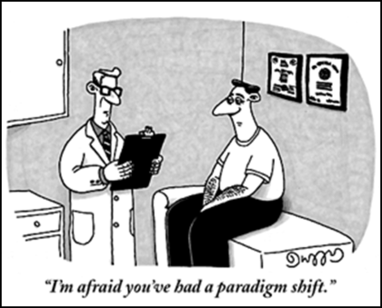
How many visits does it take to shift the patient’s paradigm about chiropractic?
Perhaps it never completely shifts, what I know for sure is that every visit is an opportunity to educate.

Slide 41
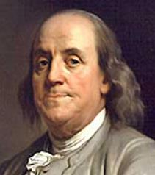
Wisdom From Ben
“Tell me & I forget.
Teach me & I remember.
Involve me & I learn.”
~ Ben Franklin
Thanks Ben! So with this in mind, as we try to get our patients to understand chiropractic, the more we can INVOLVE them in our explanations, the better they will understand & integrate our ideas into theirs.

Slide 42
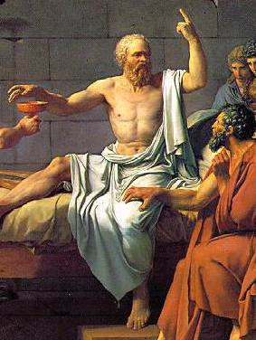
Socratic Method Of Teaching
The idea is to ask a series of questions based on logic & fact intended to help a person discover their beliefs & understanding about a given topic. In this case chiropractic. I always ask questions that I already know the answer to before I ask. So yes or no questions, simple choice questions, etc. Questions like you see lawyers ask in the movies, “your leading the witness”. YES! I’m simply guiding the patient to the truth! It is better for THEM to come to the conclusion that I want them to, versus just telling them. This IS the involvement Ben Franklin was taking about. So we’ll use this method throughout our presentation.

Slide 43

Patient Education
(public has no idea what we are selling)
Reverend Samuel H. Weed, selected two Greek words, ‘cheir’ and ‘praktikos’, meaning when combined, “done by hand” Chiropractic.
Great to help pts identify with our title.

Slide 44
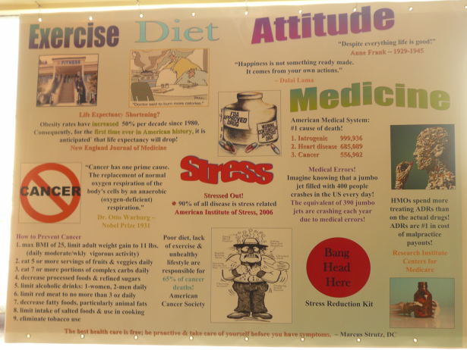
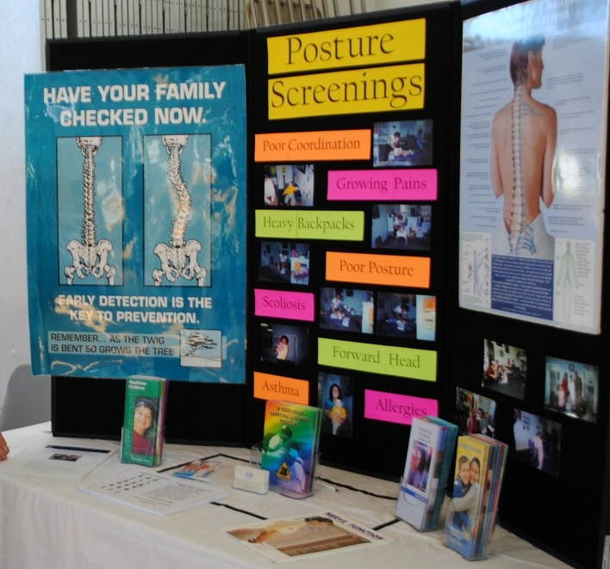
Educational Posters & Tables
Have educational posters & tables in your office. The more the better. Have a poster or table (think science fair style) for every common question so you can walk up to the poster or table & explain the concept to your patient. Have the posters printed or use butcher block paper. Design your own educational tables. Use information cards so the patient can read & learn on their own.
We have FREE posters for you on the
Back to Chiropractic website: Free Materials

Slide 45

Talk Over The Patients Head
Impress the patient on that initial visit. Most new patients have no idea about your level of education. To establish that you’re “the doctor” is crucial in your long term relationship with the patient, so that 1st impression is super important. They should be able to conclude that you are highly educated just by listening to you & that you DIDN’T just attend a weekend course.

Slide 46

How smart do you sound on a routine visit?
Okay now the patient has come in multiple times & the visit doesn’t take long. Do you still sound like that highly educated doctor you were on that first visit or are you now having routine conversations?
Record yourself & hear how you sound.

Slide 47



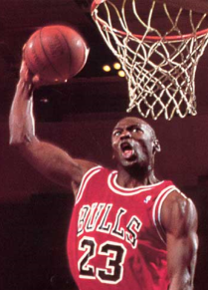


What Do You Talk About In The Office?
Holidays
Family
Finance
Sports
Weather
Politics
In Psychology there is something called Approach Tendencies.
The concept is that people tend to approach (talk about) only things they are comfortable or familiar with.
So the 6 topics above are what most of your patients would tend to want to talk about. Since they are not familiar with chiropractic they tend to NOT want to talk about it.
Have you ever had a patient visit where chiropractic & health never comes up? Don’t feel bad everyone has.
So how do we get the patient to talk about chiropractic?

Slide 48

The White Board
Did you know that 250,000 people DIE each year from IATROGENIC causes?
Point to the L5 vertebra on
the anatomy chart.
Next week: What is the Patella?
Put a white board up in your office. Ask thought provoking questions that stimulate chiropractic conversation. Multiple choice, true/false, open ended, define big words, concepts, identify on a chart or x-rays all work well. Change it daily or weekly.

Slide 49

The Chiropractic Menu
Restaurants have in house menus, a take home version & menus posted on their websites. They also post menus on their windows facing the street so when they are closed…Hmmm
Most chiropractic offices have nothing like this. Take a look around your office. Can you easily find out about all the different conditions you care for? How about the techniques & services you offer? No? Okay, let’s get started on fixing this problem.

Slide 50
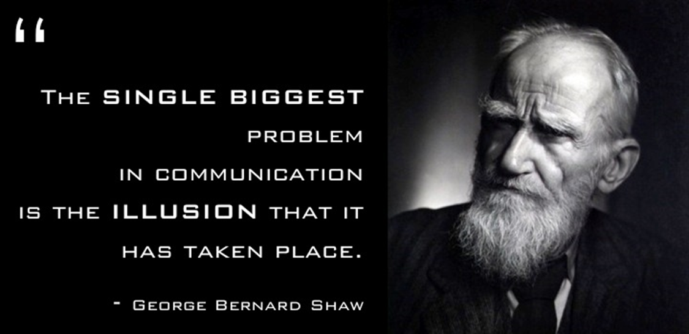
The Chiropractic Menu ~ The Initial Intake Form
New patients often have no idea what chiropractic care is all about. They come in with misconceptions & erroneous ideas that need to be addressed BEFORE they start care, so they will
have a good experience in your office.
Many DCs error on the side of explaining things once at the first visit or ROF & then assuming the patient understands forever. We need to constantly go back & review these
“NEW” ideas with the patient.

Slide 51
The Chiropractic Menu
The idea is to add to your initial intake form, perhaps 1-2 pages of information that will address these issues:
Things You Need To Know
Frequently Asked Questions (FAQs)
Misconceptions
All should be posted in your office,
on your website & available to take home.

Slide 52



Activity
Things You Need To Know,
Frequently Asked Questions & Misconceptions
Make a list of the top 10 things you want to have
your patients understand BEFORE they start care.
Brainstorm on answers & develop “scripts” for these questions. Include these on your initial intake form.
(Note: there’ll be overlap in these categories & that is okay.)
Make posters, hand-outs & post on your website.

Slide 53
Things You Need To Know, FAQs & Misconceptions
What is chiropractic? How well does it work?
Chiropractic is an alternative to pharmaceutical drugs & surgery.
Chiropractic is licensed in all 50 states & is a 4 year postgraduate program.
When to choose chiropractic if you have pain or symptoms ~ Testimonials
Why can DCs help with so many different conditions?
Pain is a poor indicator of health.
Why do I hurt when nothing happened?
When to choose chiropractic if you don’t have pain: wellness care.
  What are the non-pain benefits?
There are many different techniques & specialty areas within chiropractic.
Care is like working out or physiotherapy, (needs to be done more than once).
Once I go, I’ll have to go forever?
What is a chiropractic adjustment? How does it work?
Is chiropractic safe?
Does the adjustment hurt? Does it hurt afterwards?
Why is a visit or adjustment so short?
You can be sore after the first few visits and that is okay.
What is that popping sound?
Is the bone being popped back into place?
Are bones actually moving?
Why is the 1st adjustment so loud & all the rest not?
Add more if you like, oh here’s one, make sure they are crystal clear
about the cost upfront, no surprises.

Slide 54


When To Choose Chiropractic If
You Have Pain Or Symptoms ~ Testimonials
Testimonials are great to have posted on your website
& in your office.
Patients like to read about your success cases it makes them feel better about their own care
& boosts their confidence about you.

Slide 55
Who Do We Need As Patients
Need to get the word out about your office?
These are important people in your community who can easily spread the word. Make them your patients.
Hair Salon/Barber
Dentist
Grocery Store Clerk
Bank Teller
Post Office Clerk
UPS/FedEx Driver
MDs
(yes find 2-5 MDs who get what you are doing & work with them,
can be a great referral source)

Slide 56
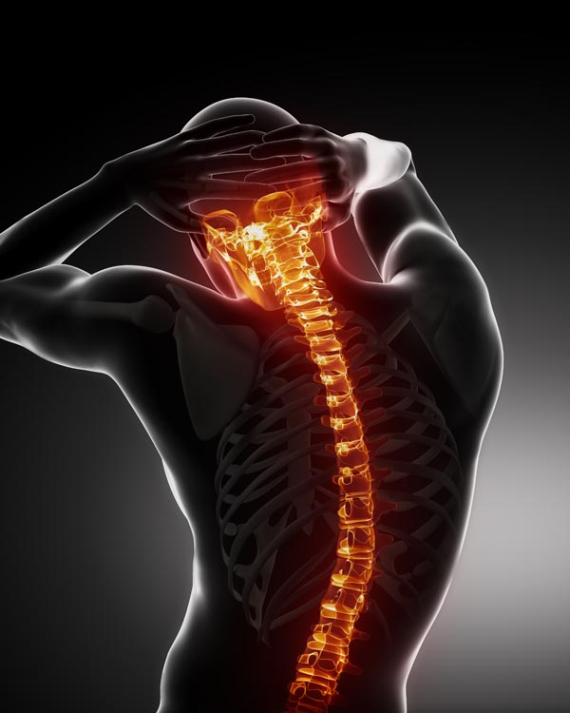
Activity
Patient Education: When To Choose Chiropractic!
Pain & Symptom Based
This should be part of your initial intake form:
Make a list of your top 20 common conditions that you care for in your office. These are your “bread & butter” high success rate cases. This list should be easily found on your office window, on your website, on your initial intake form & in your waiting room. Hmmm… he keeps saying that!

Slide 57
Common Conditions For DCs
Neck Pain
Headaches/Migraines
Shoulder Pain
Frozen Shoulder
Rotator Cuff
Elbow Pain
Wrist/Hand Pain
Carpal Tunnel Syndrome
Back Pain
Hip/SI Joint Pain
Sciatica
Knee Pain
Ankle/Foot Pain
Plantar Fasciitis
Arthritic Joints
Numbness/Tingling
Pinched Nerves
Bursitis
Fibromyalgia
Tendonitis
Motor Vehicle Injuries
Sports Injuries
Personal Injuries
Worker's Comp Injuries

Slide 58
Excerpts from the Initial Intake Form
(All of these are designed so the patient sees all the conditions & regions of the body you care for. It also begins to introduce the concept of wellness benefits.)
Reason Seeking Care: Pain/Injury Related YES NO
Wellness/Health Maintenance YES NO
Have you been to a chiropractor before? YES NO
Briefly describe that experience:
Did the last chiropractor adjust your spine? YES NO
If yes, was there a “popping” sound when they adjusted you? YES NO
Expectations of care:
How many visits to our office do you anticipate? _____
In our chiropractic office we provide many services for your health.
To get an idea of what you need please take the following survey.
How much time per day at home are you willing to commit to your goals? ______hours ______minutes

Slide 59
Please score yourself from 1 to 10 below in each health category & then indicate if you are interested in receiving help in these areas. You can select as many or as few as you like.
Neck pain: 1 2 3 4 5 6 7 8 9 10 (1 no pain at all, 10 extreme pain)
I would like help and/or info on decreasing my neck pain: Yes No
Mid-back/rib cage pain: 1 2 3 4 5 6 7 8 9 10 (1 no pain at all, 10 extreme pain)
I would like help and/or info on decreasing my mid-back/rib cage pain: Yes No
Low back pain: 1 2 3 4 5 6 7 8 9 10 (1 no pain at all, 10 extreme pain)
I would like help and/or info on decreasing my low back pain: Yes No
Shoulder pain: 1 2 3 4 5 6 7 8 9 10 (1 no pain at all, 10 extreme pain)
I would like help and/or info on decreasing my shoulder pain: Yes No
Elbow pain: 1 2 3 4 5 6 7 8 9 10 (1 no pain at all, 10 extreme pain)
I would like help and/or info on decreasing my elbow pain: Yes No

Slide 60
Wrist/hand pain: 1 2 3 4 5 6 7 8 9 10 (1 no pain at all, 10 extreme pain)
I would like help and/or info on decreasing my wrist/hand pain: Yes No
SI joint pain: 1 2 3 4 5 6 7 8 9 10 (1 no pain at all, 10 extreme pain)
I would like help and/or info on decreasing my SI joint pain: Yes No
Hip joint pain: 1 2 3 4 5 6 7 8 9 10 (1 no pain at all, 10 extreme pain)
I would like help and/or info on decreasing my hip joint pain: Yes No
Knee pain: 1 2 3 4 5 6 7 8 9 10 (1 no pain at all, 10 extreme pain)
I would like help and/or info on decreasing my knee pain: Yes No
Ankle/foot pain: 1 2 3 4 5 6 7 8 9 10 (1 no pain at all, 10 extreme pain)
I would like help and/or info on decreasing my ankle/foot pain: Yes No

Slide 61

Why Can DCs Help With So
Many Different Conditions?
Great question! Patients are often confused why you can help with so many seemingly unrelated conditions.
The secret of course is all these conditions are either directly or indirectly related to joint motion. Whether it’s a specific soft tissue joint problem or a neurological or vascular system issue, improving joint motion can help with many conditions.
See list of common conditions cared for by DCs.
61

Slide 62
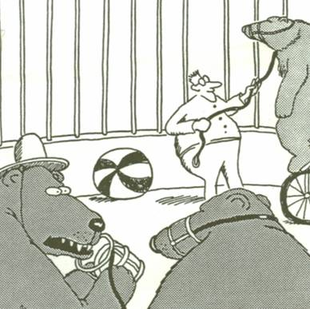

Wellness Care: When To Choose Chiropractic If You Don’t Have Pain Or Symptoms.
What Are The Non-pain Benefits?
Let the discovery of wellness begin!
“Well, hey… These
things just snap right off.”

Slide 63


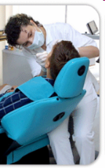
Myth Buster ~
I don’t need a Chiropractor, my pain is gone. Pain is often the first thing to go in the healing process; think broken arm. Cancer & diabetes can develop for years before you’re aware of symptoms. If you’re feeling good couldn’t you feel even better? Think dental care, oil change & proactive health! Wellness care, adjusting areas that don't hurt?

Slide 64
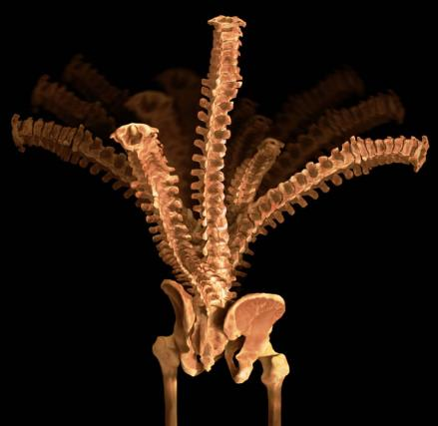
Physiological Response To
A Chiropractic Adjustment Other Than Pain Relief
Get some motion in that spine!

Slide 65
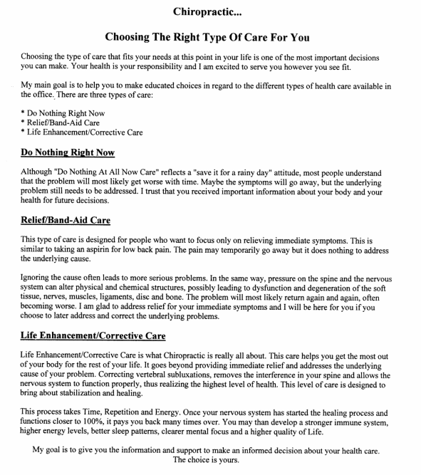

backtochiropractic.net
Free Materials

Slide 66
The Chiropractic Experience
Corrects the cause, doesn’t just treat symptoms
Improves immunity, overall body function & overall health
Relief from pain & symptoms
Quicker recovery & back to work faster
Can prevent surgery
Safe, painless & affordable health care
Natural, no drugs or needles
backtochiropractic.net
Free Materials

Slide 67

Restores normal nerve supply
Normalizes blood flow
Slows spinal degeneration & improves disk health
Improves posture & restores mobility
Relieves stress, tension & increases energy
Slows aging
Improves athletic performance
Allows better sleep
backtochiropractic.net
Free Materials

Slide 68
Benefits of Chiropractic in Asymptomatic Pts
Studies reported improvements in neurocognitive function, visual field blind spot analysis, visual acuity, salivary cortisol levels, muscle strength & savings in health care costs.
Improved: ROM, muscle strength, surface EMG, immune response, endorphin levels, BP, heart rate & spirometry.
Significant changes: agility, balance, kinesthetic perception, power & speed reaction in asymptomatic athletes.

Slide 69
The Benefits of Adjustments
All tissues of the back: muscles, ligaments, jt capsules & discs - respond & heal well when adjusted.
1. Restores motion - symmetry & ROM
2. Normalizes biomechanics & load distribution
3. Pumps out waste products & edematous fluid
4. Improves discs & articular cartilage nutrition
5. Relaxes tight muscles
6. Normalizes proprioception

Slide 70
7. Stimulates sensory-motor reflexes improving dynamic muscular stabilization of jts
8. Accelerates healing - as movement:
⇑ metabolic rate
⇑ collagen & protein production
9. Improves alignment of new connective tissue
Malik Slosberg, DC
Negative Effects of Immobilization-Deconditioning Syndrome
Craig Liebenson, DC
backtochiropractic.net
Free Materials

Slide 71
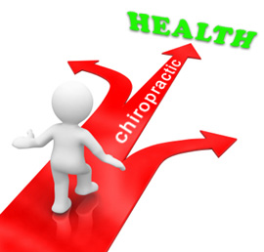
Activity
When To Choose Chiropractic Wellness Care!
This should be part of your initial intake form:
Make a list of the top 20 wellness (non-pain or symptom) benefits of chiropractic care. This list should be easily found on your office window, on your website, on your initial intake form & in your waiting room.
Hmmm… he said it again!

Slide 72


Wellness (non-pain or symptom)
Benefits Of Chiropractic Care
Activities Of Daily Living
Athletic Performance
Balance
Blood Pressure
Breathing Measurements
Decreased Stress
Fewer Colds
Increased Flexibility
Increased Range of Motion
Improved Digestion
Improved Posture
Improved Sleep Patterns
Increased Energy
Neurological Test Improvements
Orthopedic Test Improvements
Pulse
Respiration Rate
Strength Prevention of Surgery Weight Loss BMI
Mental Clarity
Attitude Improvement

Slide 73

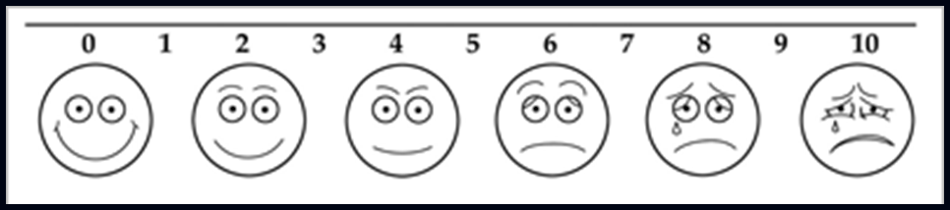
Activity: Measuring Wellness Benefits?
How do we measure wellness?
We’ll subjectively measure the categories from the previous slide. Instead of objective measurements, (yes keep doing those in your office), for the wellness we will simply just ask the patient their opinion or subjective measurements. I’ve created an initial intake form that asks how the patient feels they rate in the wellness categories on a scale of 1-10. After 1-3 months they take it home & score themselves again. As they go through each category they will see that chiropractic makes noticeable & measurable changes.
This validates chiropractic wellness care from THEIR perspective, they now have proven to themselves that it works.

Slide 74
Please score yourself from 1 to 10 below in each health category and then indicate if you are interested in receiving help in these areas. You can select as many or as few as you like.
Energy level: 1 2 3 4 5 6 7 8 9 10 (1 low energy, 10 high energy)
I would like help and/or info on increasing my energy level: Yes No
Diet and nutrition: 1 2 3 4 5 6 7 8 9 10 (1 horrible diet, 10 excellent diet)
I would like help and/or info on improving my diet and nutrition: Yes No
Exercise program: 1 2 3 4 5 6 7 8 9 10 (1 horrible exercise habits, 10 excellent habits)
I would like help and/or info on exercise: Yes No
Ability to sleep well: 1 2 3 4 5 6 7 8 9 10 (1 horrible sleeper, 10 excellent sleeper)
I would like help and/or info on getting a good night’s sleep: Yes No
Stress level: 1 2 3 4 5 6 7 8 9 10 (1 no stress at all, 10 extreme stress)
I would like help and/or info on decreasing my stress: Yes No
Headache frequency: 1 2 3 4 5 6 7 8 9 10 (1 constant headaches, 10 never)
I would like help and/or info on decreasing my headaches: Yes No

Slide 75
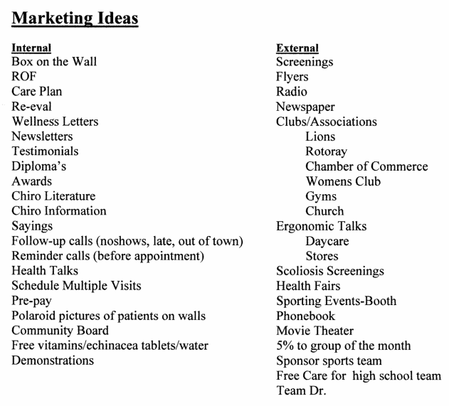

Internal & External Marketing Ideas ~ Try some
backtochiropractic.net Free Materials

Slide 76
Please score yourself from 1 to 10 below in each health category and then indicate if you are interested in receiving help in these areas. You can select as many or as few as you like.
Posture: 1 2 3 4 5 6 7 8 9 10 (1 poor posture, 10 perfect posture)
I would like help and/or info on improving my posture: Yes No
Breathing: 1 2 3 4 5 6 7 8 9 10 (1 poor breather, 10 good breather)
I would like help and/or info on improving my breathing: Yes No
Blood pressure: 1 2 3 4 5 6 7 8 9 10 (1 poor blood pressure, 10 normal blood pressure)
I would like help and/or info on improving blood pressure: Yes No
Add as many as you like!

Slide 77
These next two are super important as they matter the MOST to the patient.
Daily Activities: 1 2 3 4 5 6 7 8 9 10 (1 unable to perform, 10 able to perform)
(ex: house chores, driving distance, sitting extended period, etc)
I would like help and/or info on improving my ability to perform daily activities: Yes No
Please list 5 activities of daily living you can’t perform at 100% (ex: house chores, driving distance, sitting extended period, etc)
1.
2.
3.
4.
5.

Slide 78
Enjoyable Activities: 1 2 3 4 5 6 7 8 9 10 (1 unable to perform, 10 able to perform)
(ex: golf, gardening, play with kids)
I’d like help and/or info on improving my ability to perform enjoyable activities: Yes No
Please list 5 activities that you really enjoy that you can’t perform at 100% (ex: golf, gardening, play with kids)
1.
2.
3.
4.
5.

Slide 79
Here is a sample of the Wellness Re-Eval Form
Follow-up Health Evaluation Date_______
Please circle Increased/Decreased or Improved/Worsened in each health category and write in by what percent.
Neck pain: Increased or Decreased by _____%
Mid-back/rib cage pain: Increased or Decreased by _____%
Low back pain: Increased or Decreased by _____%
Shoulder pain: Increased or Decreased by _____%
Elbow pain: Increased or Decreased by _____%
Wrist/hand pain: Increased or Decreased by _____%
SI joint pain: Increased or Decreased by _____%
Hip joint pain: Increased or Decreased by _____%
Knee pain: Increased or Decreased by _____%
Ankle/foot pain: Increased or Decreased by _____%

Slide 80
Energy level: Increased or Decreased by _____%
Diet and nutrition: Improved or Worsened by _____%
Exercise program: Improved or Worsened by _____%
Ability to sleep well: Improved or Worsened by _____%
Stress level: Increased or Decreased by _____%
Headache frequency: Increased or Decreased by _____%
Posture: Improved or Worsened by _____%
Breathing ability: Improved or Worsened by _____%
Blood pressure: Increased or Decreased by _____%

Slide 81
Score the activities of daily living that you put on your initial health form by % Improved or Worsened.
1.
2.
3.
4.
5.
Score the activities you really enjoy that you put on your initial health form by % Improved or Worsened.
1.
2.
3.
4.
5.

Slide 82
Care Is Like Working Out Or Physiotherapy:
(it needs to be done more than once)
A friend went to a PT for knee rehab & the PT said, “this is NOT like chiropractic which takes just one visit”.
There is a common misconception that a chiropractic adjustment is popping the bone back into place & it should take just one visit. Yikes! That is a dislocation.
(please see slides on popping sound & the adjustment)
DCs need to educate their patients on the actual process that is occurring rather than allowing them to continue to believe this erroneous idea.
Joints, soft tissue & systems (musculoskeletal, nervous, cardiovascular & respiratory systems primarily) are being reconditioned. This takes time, much like the gym.
Imagine going to the gym just once!

Slide 83

Once I go, do I have to go forever? NO!
Be sure that this is on your initial intake form. We DON’T want the patient to be worried about this. Give them a prognosis & time table for their condition & then an option for wellness care.
They should only come in as long as they want the benefits of chiropractic care. So we must educate them about the wellness benefits of care.
Analogies: exercise, diet, dental care, car tune-up. All of these are done on a maintenance level as well. Ask the patient why they do these things. Let them know that chiropractic isn’t just about eliminating symptoms, it’s about gaining, maintaining & improving ones health.
111

Slide 84
What Is A Chiropractic Adjustment? How Does It Work?
Bend your finger back until it's painful. A biopsy won't reveal a tumor, infection or any lesion. But releasing the finger & letting it return to its "position of comfort" will allow the pain to subside. We need to think about low back pain in a similar way -functionally. 97% of back pain seen by primary care physicians is mechanical in origin -there's something wrong with the muscles, ligaments or connective tissues.
Physician & Sports Medicine, 1997.

Slide 85
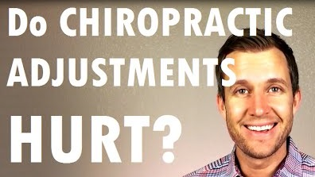
Does The Adjustment Hurt?
Depends who you ask & the condition of the patient.
The actual adjustment itself, while it is happening,
(which is less than 1 second)
may feel sudden, startling, compressive & uncomfortable,
but usually do not cause pain & if so just for a moment.
Many say it doesn’t hurt at all.
Some may say it hurts if they have acute muscle spasms or inflammatory chemical build-up.
Remember the patient may anticipate pain, so debriefing them is important.

Slide 86
Does It Hurt Afterwards?
Inform the patient that after an adjustment they may be sore regardless of the stage of healing. This can last 1-3 days & is NORMAL. Why? During the acute stage due to ⇑ inflammation, during the chronic stage by releasing trapped chemicals & starting new inflammation. This chemical flow (old-out, new-in) is essential for tissue healing. If you don’t explain this,
patients will leave thinking you hurt them.
Differentiate between hurt & injured so you & the patient are talking about the same thing. The last DC hurt me? Was something broken/torn or were you just really sore?

Slide 87

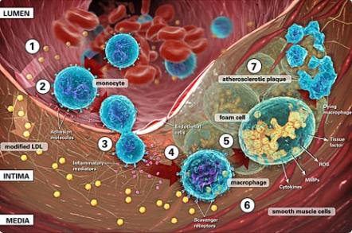
Inflammation & Pain:
Does the patient think these are good or bad things?
Remember the acute inflammatory process is what helps heal the tissue. If we could remove all the inflammatory chemicals the tissue would NOT heal. Have pt pinch themselves then release. Severity of pain does not always correlate with severity of injury.
Ex. Calf cramp, paper cut, bumping your elbow.

Slide 88
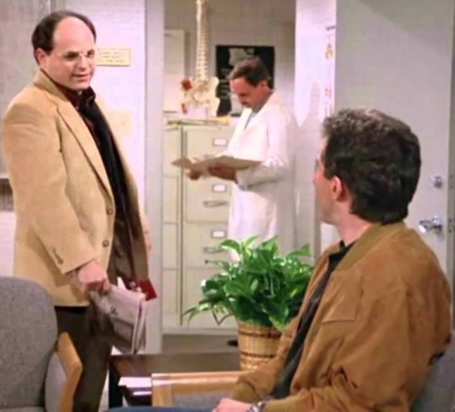
Why Is A Visit Or Adjustment So Short?
Often patients think a chiropractic visit is too short. They equate length of time of a visit with effectiveness. Explain to them BEFORE their 1st adjustment why visits are quick. YES they need to learn about Golgi tendon organs & their response to a quick chiropractic adjusting thrust. Make the shortness of the visit a positive versus a negative.
“I was in there for 2 minutes, he didn’t do anything!”
133

Slide 89
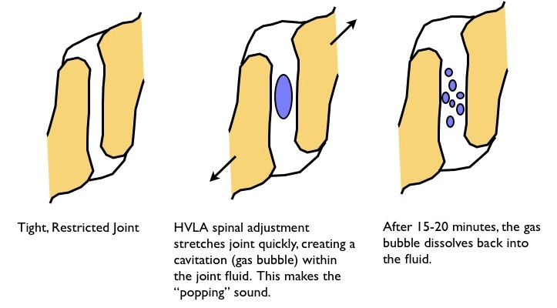
What’s That “Popping” Sound? Is the bone being popped back into place?
Synovial fluid in your joints contains oxygen, nitrogen and carbon dioxide gases. When a joint is adjusted the joint capsule is stretched & the joint volume is increased by as much as 15-20%. This creates a partial vacuum & the gas rapidly releases due to the pressure change.
(Similar to Boyle's Law, 1662).
The gas takes about 20 minutes to return to the synovial fluid
& then it could be “popped” again.
134

Slide 90
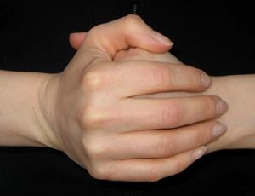
The Missed Adjustment
Patients feel like you failed if there is no sound.
The truth is the joint was not gapped far enough to cavitate. This occurs because the soft tissue is too tight to allow for the cavitation OR the DC…
The patient wants to hear the “pop” & get that rush from the endorphins being released.
Let them know the joint still moved & muscles did relax. An active ROM exam will demonstrate this.

Slide 91
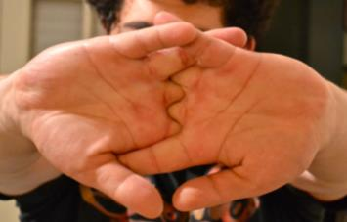
No Audible?
Pt: “I guess it didn’t need to be adjusted.”
or they think the joint didn’t move at all.
Try this: Crack a knuckle in your finger & show the patient how far it moved. Then do it again & show pt that the joint moves the same distance regardless if it “pops”.

Slide 92
Myth Buster
My back is out, can’t you just put it in?
Backs DO NOT go in & out. Chiropractors DO NOT realign the spine, we increase the range-of-motion. An x-ray would show your spine in the exact same place before & after an adjustment. Why? The spine is held together with ligaments, that DO NOT instantly change length. Chiropractors adjust “subluxated/fixed” jts, which allows the jt to move through a greater ROM.
Imagine how many pts you would have injured in your Chiro college clinic days if the bones did change position.

Slide 93


Are Bones Actually Moving?
Bend your finger & let it go.
Does it stay misaligned? NO! Why not?
Soft tissue DOESN’T change length instantly,
nor does it after an adjustment!
Did the bones move?
Yes, but they returned to their neutral position.
The patient needs to understand this, so they do NOT continue to think the bone is moving back “in”!
Crack all your knuckles. Do they become misaligned? NO!

Slide 94
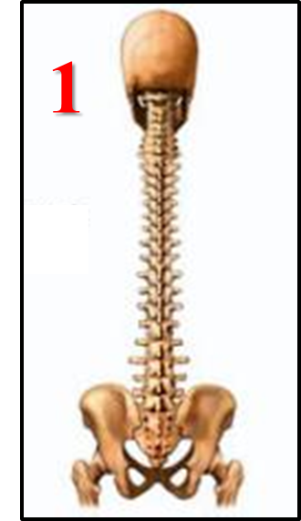
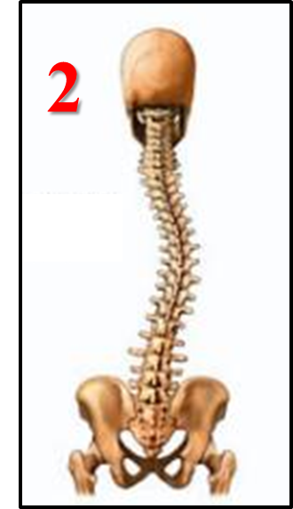
Misalignment Misconception
Questions to ask your patients to better understand chiropractic care:
DCs question: Which area for pt #1 and #2 need to be adjusted?
Patient: Pt 1 does not need an adjustment, Pt 2 at the misalignment
DCs question: Which patient is in the most pain?
Patient: Pt 1 has no pain, Pt 2 has pain as they have a crooked spine
DCs question: Is it possible for patient #2 to be pain free?
Patient: no they have a crooked spine
And now you get to explain the real answers!

Slide 95
More Questions
DCs question: Did pt #1 or #2 get hit by a car?
Patient: no way as Pt 1’s spine is straight, Pt 2 looks like they got hit
DCs question: Can pt #2 be realigned with one adjustment?
Patient: yes often one chiropractic visit pops the spine back in place
DCs question: If pt #1 is pain free & moving normal, do they need care?
Patient: no, everything is fine
And now you get to explain the real answers!

Slide 96
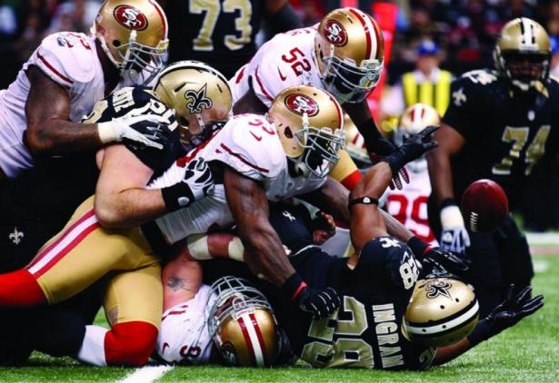
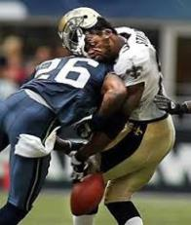
Great example for patients:
NFL players X-rays are identical before & after games!
Retired players just have major spinal degeneration, but NOT scoliosis!

Slide 97
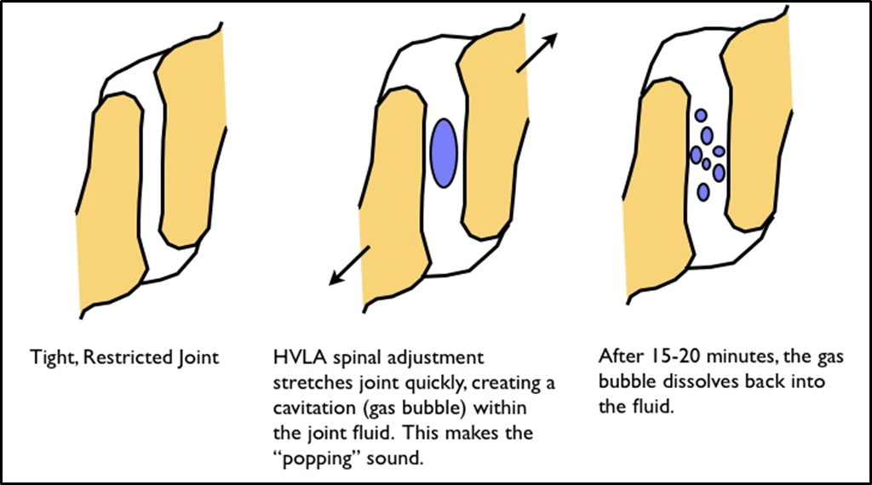
Why Is The 1st Adjustment So Loud?
The joint capsule volume change is typically greatest on the 1st adjustment, as it has never been adjusted & will likely have tighter muscles & more adhesions. The sound on subsequent adjustments SHOULD be less & is a good indicator that the joint is moving more efficiently. Tell your patient you EXPECT there to be less noise NOT more & that this is a good thing. Otherwise they will think you failed or are not trying or don’t care.
136

Slide 98
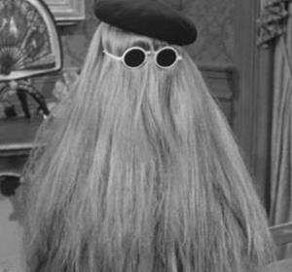
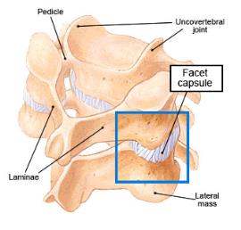
Did you get “It”? “I got it”
Pts DO NOT know what “it” is, so be careful what you say! They likely have no idea what a joint complex is or how it functions.
A small word like “it” needs to be defined in your office so when we do use the word the patient knows what we are referring to & that we are communicating effectively.
IT?

Slide 99
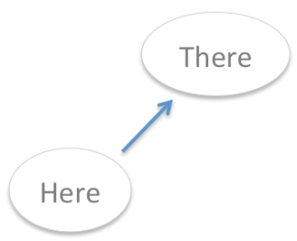
Watch What You Say!
Did “it move”? Is “it” in? These phrases imply that the bone moved from “here to there”. When in fact the bone moved from “here to here”.
Few things in our world move from here to here!
The bone has NOT moved to a new location. Instead the joint can now move through a more complete ROM.

Slide 100

Myth Buster ~
I can crack my own spine
so I don’t need to go?
When you self adjust you’re likely moving the jts that are easy to move or hypermobile. Typically you aren’t adjusting the correct joint, it feels good for a moment (endorphins release & muscles relax) but you’ll have to repeat the process multiple times in a day.
Fact: DC’s choose to get adjusted by another DC instead of doing it themselves.

Slide 101

Group Discussion
How often should someone get adjusted?
One time per month? Is this often enough if the physiological effects of lack of motion begins with-in 4 hrs?

Slide 102
Analogies For Pts
How often should someone:
eat fruits & vegetables
work out
stretch
Once a month? No! To change & maintain the physiology of tissue, the above things need to be done often if not daily. What about the adjustment?

Slide 103

I hope you enjoyed the course. Please feel free to provide feedback.
Check out: Back To Chiropractic Resource Pages
Chiropracticpedia Informational website for chiropractic patients
Free Materials Over 200 files: Posters, newsletters & more
Adjusting & Office Skills Free help from DCs that care
DCs Looking For DCs Looking to hire, or for a job?
Chiropractic Neurologists
Classifieds Looking to buy or sell a Practice
Memorials Tributes to great DCs who have passed
​
Marcus Strutz DC
Back To Chiropractic CE Seminars
33000 North Highway 1
Ft Bragg CA 95437
707.972.0047

