Slide 1
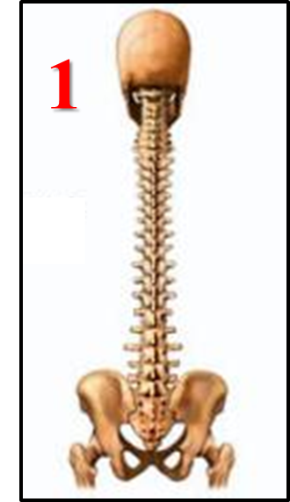
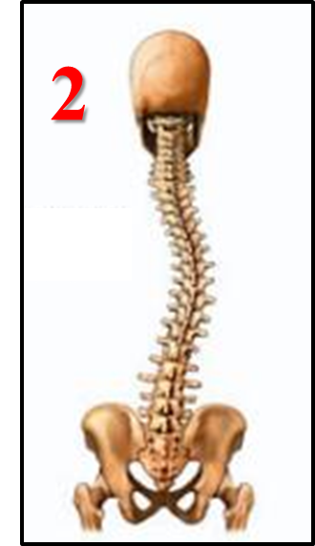
Misalignment & Chiropractic Care
Questions to consider to better understand
chiropractic care?
Which area for patient #1 and #2 need to be adjusted?
Which patient is in the most pain?
Is it possible for patient #2 to be pain free?
Did patient #1 or #2 get hit by a car?
Can patient #2 be realigned with one adjustment? Why not?
If patient #1 has no pain and is moving normally, should they get adjusted? Why or why not?

